Slide 1


Winner/Vecta Link Project
May 2024

Slide 2
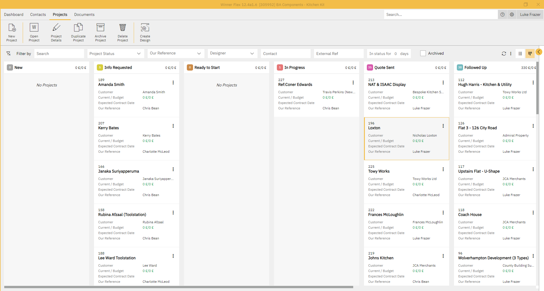
Project Home

Slide 3
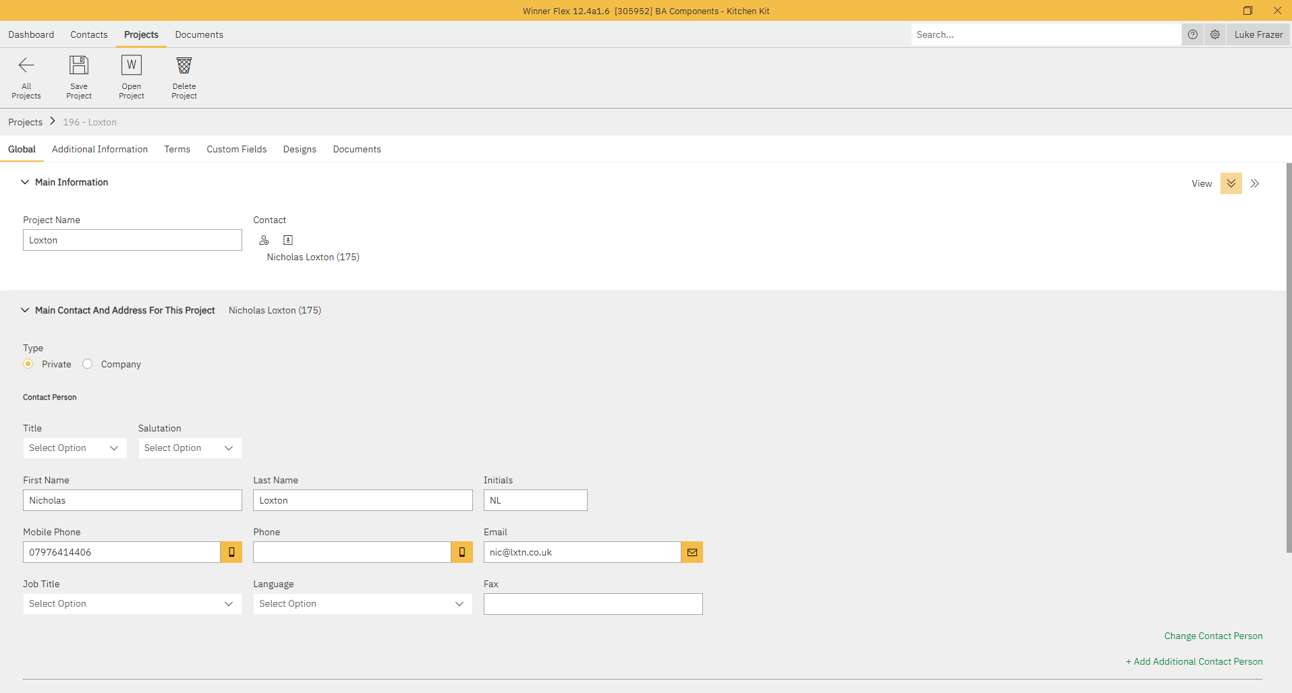
Customer Information

Slide 4
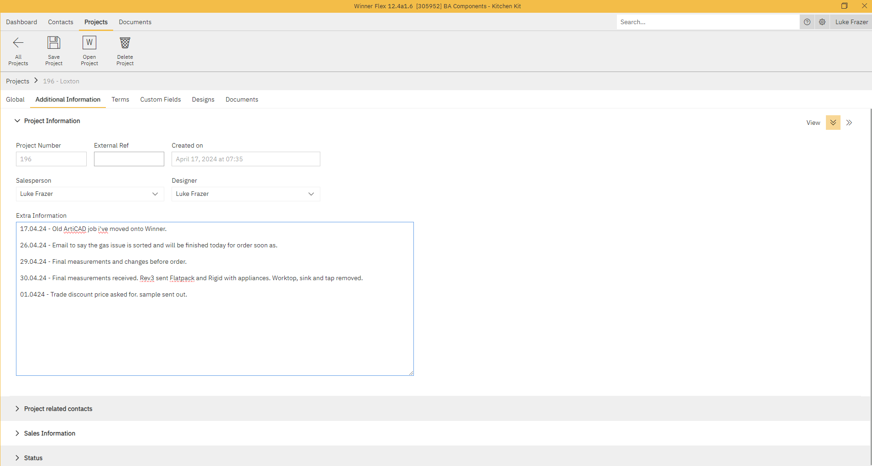
Additional Information
Account Number

Slide 5
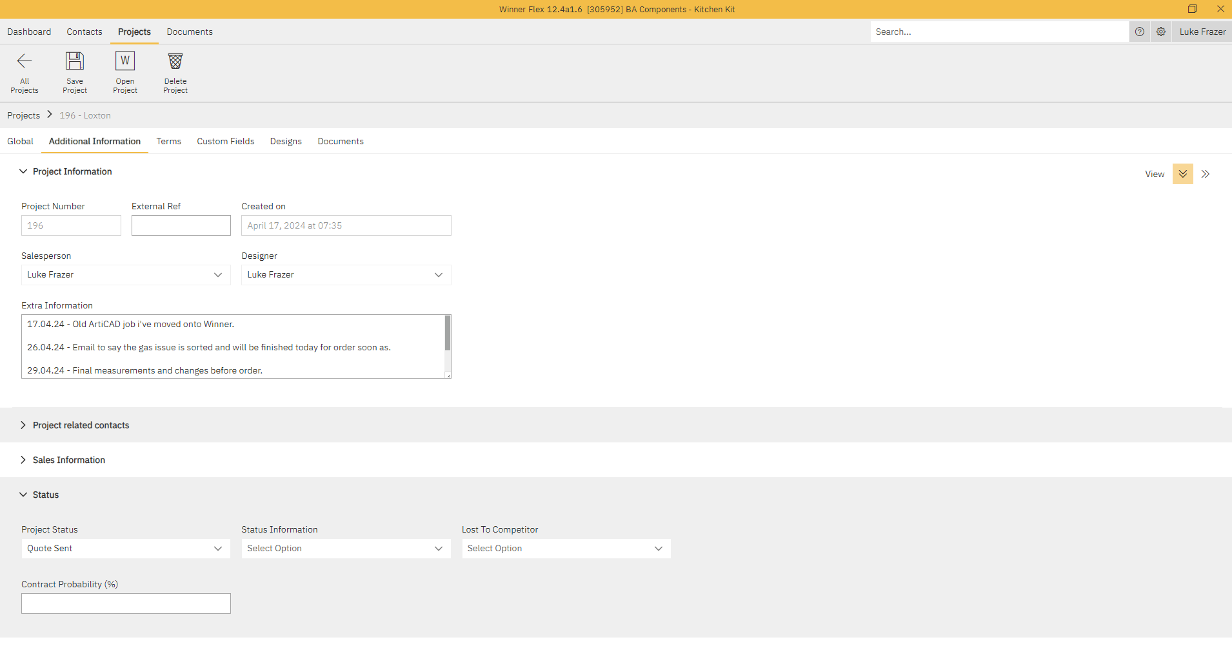

Slide 6
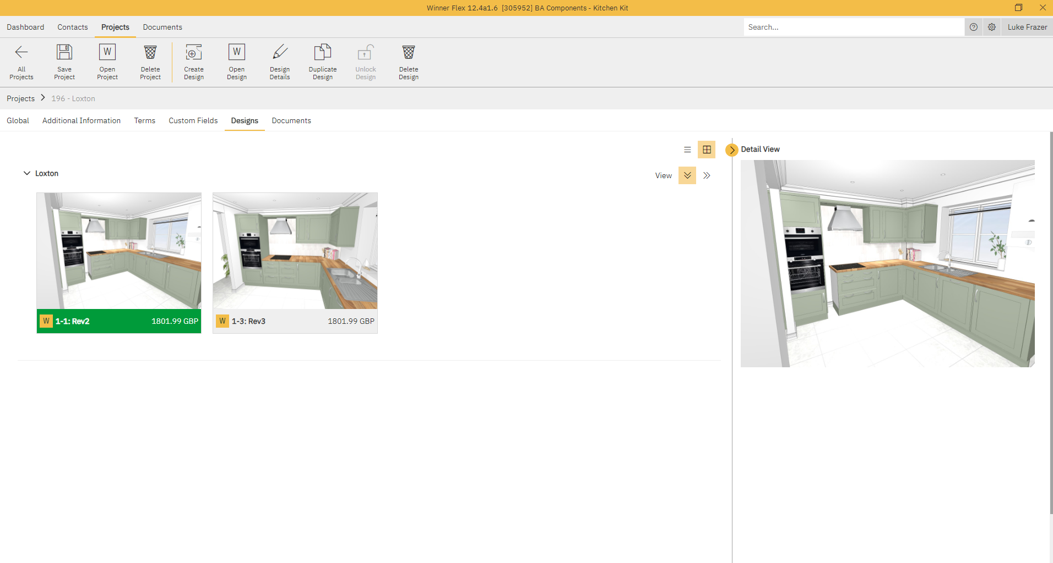

Slide 7
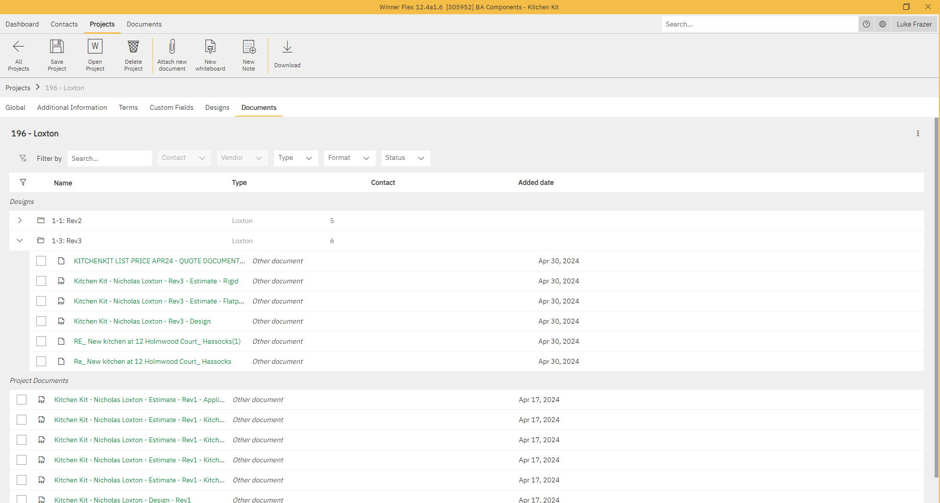

Slide 8
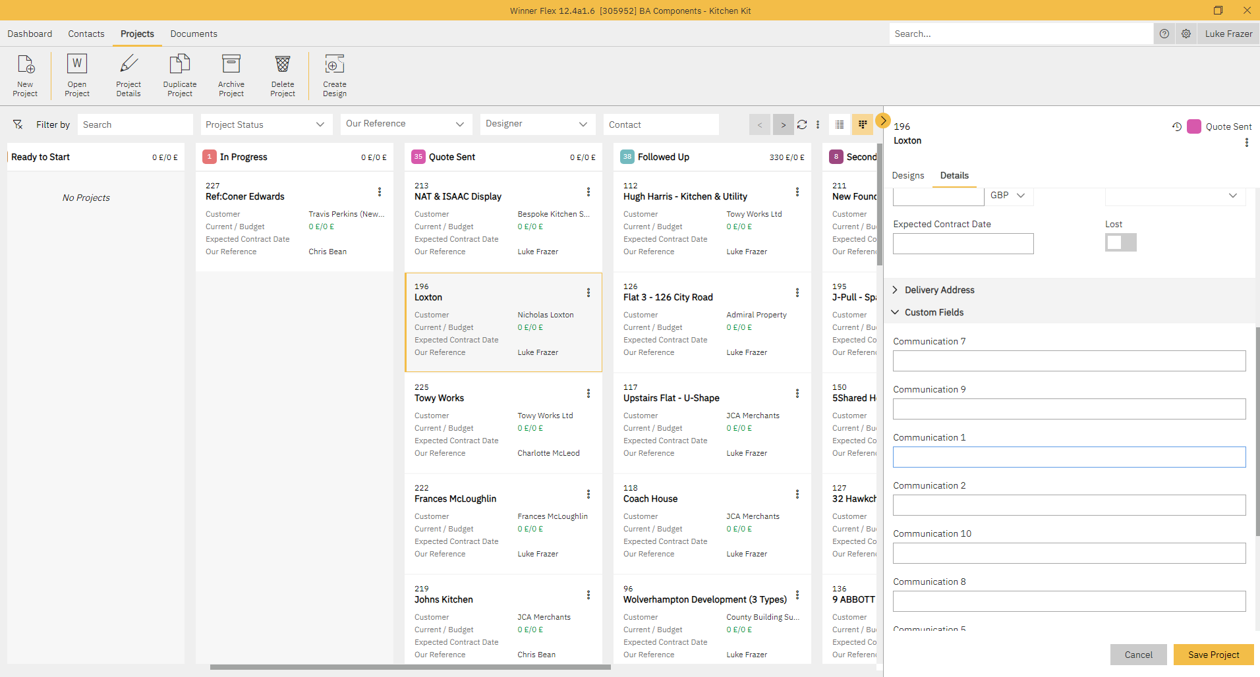

Slide 9
Process Map – Global Proposal
Vecta
Vecta reads project number from Winner Flex, and via API transfers key information for every design enquiry e.g. Project value, project status, designer name etc.
Winner
Winner design process begins, Flex CRM entry auto creates for customer.
Flex design entry is allocated to one of the progress statuses e.g. Design sent.
API
API between Winner & Flex identifies x-ref and updates the Vecta enquiry to replicate the status of the Winner Flex entry i.e. Information Requested/Design sent etc.
E-commerce copied into all correspondence between designers and customer
Customer Enquiry
Customer design enquiry received from Retailer/KK Merchant/Toolstation
Design enquiry qualified and defined by relevant person, with all required information gathered for design to commence.
Flex project number is generated e.g. 123.
Designer ensures customer account number is populated.

Slide 10
Process Map – e-Commerce
Vecta
Claire enters customer lead details on Vecta upon enquiry as a task against a prospect/account
Details passed to Design Team via email which includes account number/prospect number
Winner
Winner design begins, Flex CRM entry auto creates
API
API between Winner & Flex identifies prospect/account number and updates the Vecta enquiry to replicate the status of the Winner Flex entry i.e. Project number, design status, design value etc.
E-commerce copied into all correspondence between designers and customer throughout sale process
Project number is shared with Claire (this is then added to the Vecta task)
Flex design entry is allocated to one of the progress statuses
When sale is complete or prospect dead, API updates Vecta entry.
Customer Enquiry
Customer design enquiry received
Design enquiry qualified and defined by Claire, with all required information gathered for design to commence.

Slide 11
Design Statuses
New
Information requested
Ready to start
In progress
Quote sent
Followed up
Followed up 2
Order placed
Dead

